Slide 1
IILM UNIVERSITY
Industrial Internship Report
Password Manager
A Python-based command-line credential manager
Aayush Raj
Roll No.: 2410030950 | Section: 3CSE23 | Batch: 2024-2028
Program: B.Tech CSE | Internship Domain: Python Programming
Internship Period: 04 August 2026 – 05 September 2026
In collaboration with Upskill Campus, The IoT Academy and UniConverge Technologies (UCT)

Slide 2
AGENDA
What this report covers
Introduction & Organization Profile
Problem Statement & Objectives
1
2
Scope, Technologies & Architecture
Methodology & Implementation
3
4
Testing, Results & Learnings
Future Work & Certificate
5
6
02

Slide 3
INTRODUCTION
Why a Password Manager, and what it does
Built as a practical, hands-on project during a Python Programming internship — not a standalone exercise.
Solves a real, everyday problem: keeping track of website credentials without scattered notes.
Brings together functions, loops, conditionals, dictionaries, file handling and JSON in one working tool.
On launch, shows a simple menu: add a password, view saved passwords, or exit.
Persists everything between runs in a local file, passwords.json.
At a glance
Language
Python
Storage
JSON file
Interface
Command-line menu
Duration
4 Weeks
Version Control
GitHub
03

Slide 4
ORGANIZATION PROFILE
How the internship was structured
Delivery Partners
Upskill Campus, The IoT Academy and UniConverge Technologies (UCT)
1
Format
Guided learning modules combined with knowledge checks and a hands-on project
2
Progression
Weekly Python modules building up to one complete, working application
3
Final Deliverable
A tested Password Manager, published to a public GitHub repository
4
04

Slide 5
PROBLEM STATEMENT
The problem this project solves
The everyday pain point
What this project delivers
People juggle credentials for dozens of online services.
Managing them manually — notebooks, sticky notes, scattered files — is disorganised and easy to lose track of.
There's no simple, structured way to store and retrieve them locally without a heavyweight tool.
A small application that accepts website credentials and stores them in one structured local file.
A menu-driven interface to retrieve saved credentials on demand.
A base to build on — this version is deliberately simple, with security features flagged as future work.
05

Slide 6
PROJECT OBJECTIVES
What I set out to build and learn
Develop a functional Password Manager using Python
Apply functions, conditionals, loops and file handling together
Store credentials in a structured JSON format
Provide add and view operations via a CLI menu
Practice testing and debugging on a real, working program
Gain experience publishing code on GitHub
06

Slide 7
SCOPE OF THE PROJECT
What's in — and deliberately out — of this version
In scope
Out of scope (for now)
Local credential entry via command line
JSON-based persistent storage
Add and view operations
Basic invalid-input handling
Encryption of stored credentials
Master-password authentication
Protected key storage
Cloud / remote synchronization
This version is an educational prototype — these gaps are covered under Future Work.
07

Slide 8
TECHNOLOGIES & TOOLS
The stack behind the application
Python
Programming Language
Application logic and user interaction
JSON
Data Format
Local structured storage
json, os
Standard Libraries
Serialization and file-existence checks
Visual Studio Code
IDE
Editing, debugging and execution
GitHub
Version Control
Hosting the source for submission
08

Slide 9
SYSTEM ARCHITECTURE
How a menu choice becomes a saved record
1
2
3
4
5
User Input
(Menu Choice)
→
Menu
Processing
→
Add / View /
Exit Logic
→
JSON Storage
(passwords.json)
→
Console
Output
Separating each operation into its own function kept the program easy to test piece by piece, and easy to extend later without touching unrelated code.
09

Slide 10
METHODOLOGY
Six steps, start to finish
1
2
3
Requirement Understanding
Design
Implementation
Defined the core operations a minimal password manager needs.
Split the program into functions: load, save, add, view.
Used a dictionary in memory and the json module to persist it.
4
5
6
User Interaction
Testing
Version Control
Wrapped it in a loop with a text menu and conditional routing.
Ran valid and deliberately invalid inputs to check behaviour.
Pushed the finished code to a public GitHub repository.
10

Slide 11
PROJECT IMPLEMENTATION
Under the hood: two small functions carry the storage
load_passwords()
Checks whether passwords.json exists and loads it; otherwise starts with an empty dictionary.
save_passwords(data)
Writes the current dictionary back to the file in readable, indented JSON.
add_password() / view_passwords()
Collect a new entry and insert it into the dictionary, or read back and print all saved records.
PasswordManager.py
import json
import os
FILE = "passwords.json"
def load_passwords():
if os.path.exists(FILE):
with open(FILE, "r") as f:
return json.load(f)
return {}
def save_passwords(data):
with open(FILE, "w") as f:
json.dump(data, f, indent=4)
11

Slide 12
TESTING & RESULTS
Every core scenario passed
TC-01
Application start
Main menu appears
PASS
TC-02
Add credential
Credential saved to file
PASS
TC-03
View credentials
Saved credentials listed
PASS
TC-04
Empty storage
"No passwords saved" message
PASS
TC-05
Exit
Program terminates cleanly
PASS
TC-06
Invalid option
"Invalid choice" message
PASS
12

Slide 13
MY LEARNINGS
From syntax to a working application
Technical
Professional & Career
Functions, control flow and loops for a menu-driven app
Dictionaries for structured in-memory data
Reading and writing files
JSON serialization and deserialization
Basic input handling and debugging
Managing a GitHub repository
Breaking a vague requirement into concrete, buildable steps
Testing each piece as I went, not just at the end
Being upfront in docs about what the project doesn't do yet
Sharpened interest in databases, security and interfaces beyond the CLI
13

Slide 14
FUTURE WORK SCOPE
Turning the prototype into something usable
Security
Functional
Engineering
Encrypt stored credentials
Add master password / login
Manage encryption keys properly
Mask password input
Random strong-password generator
Search, edit and delete entries
Password-strength check
Categories, notes, timestamps
Move to SQLite as data grows
Automated unit tests
Simple GUI or web front end
Logging & exception handling
14

Slide 15
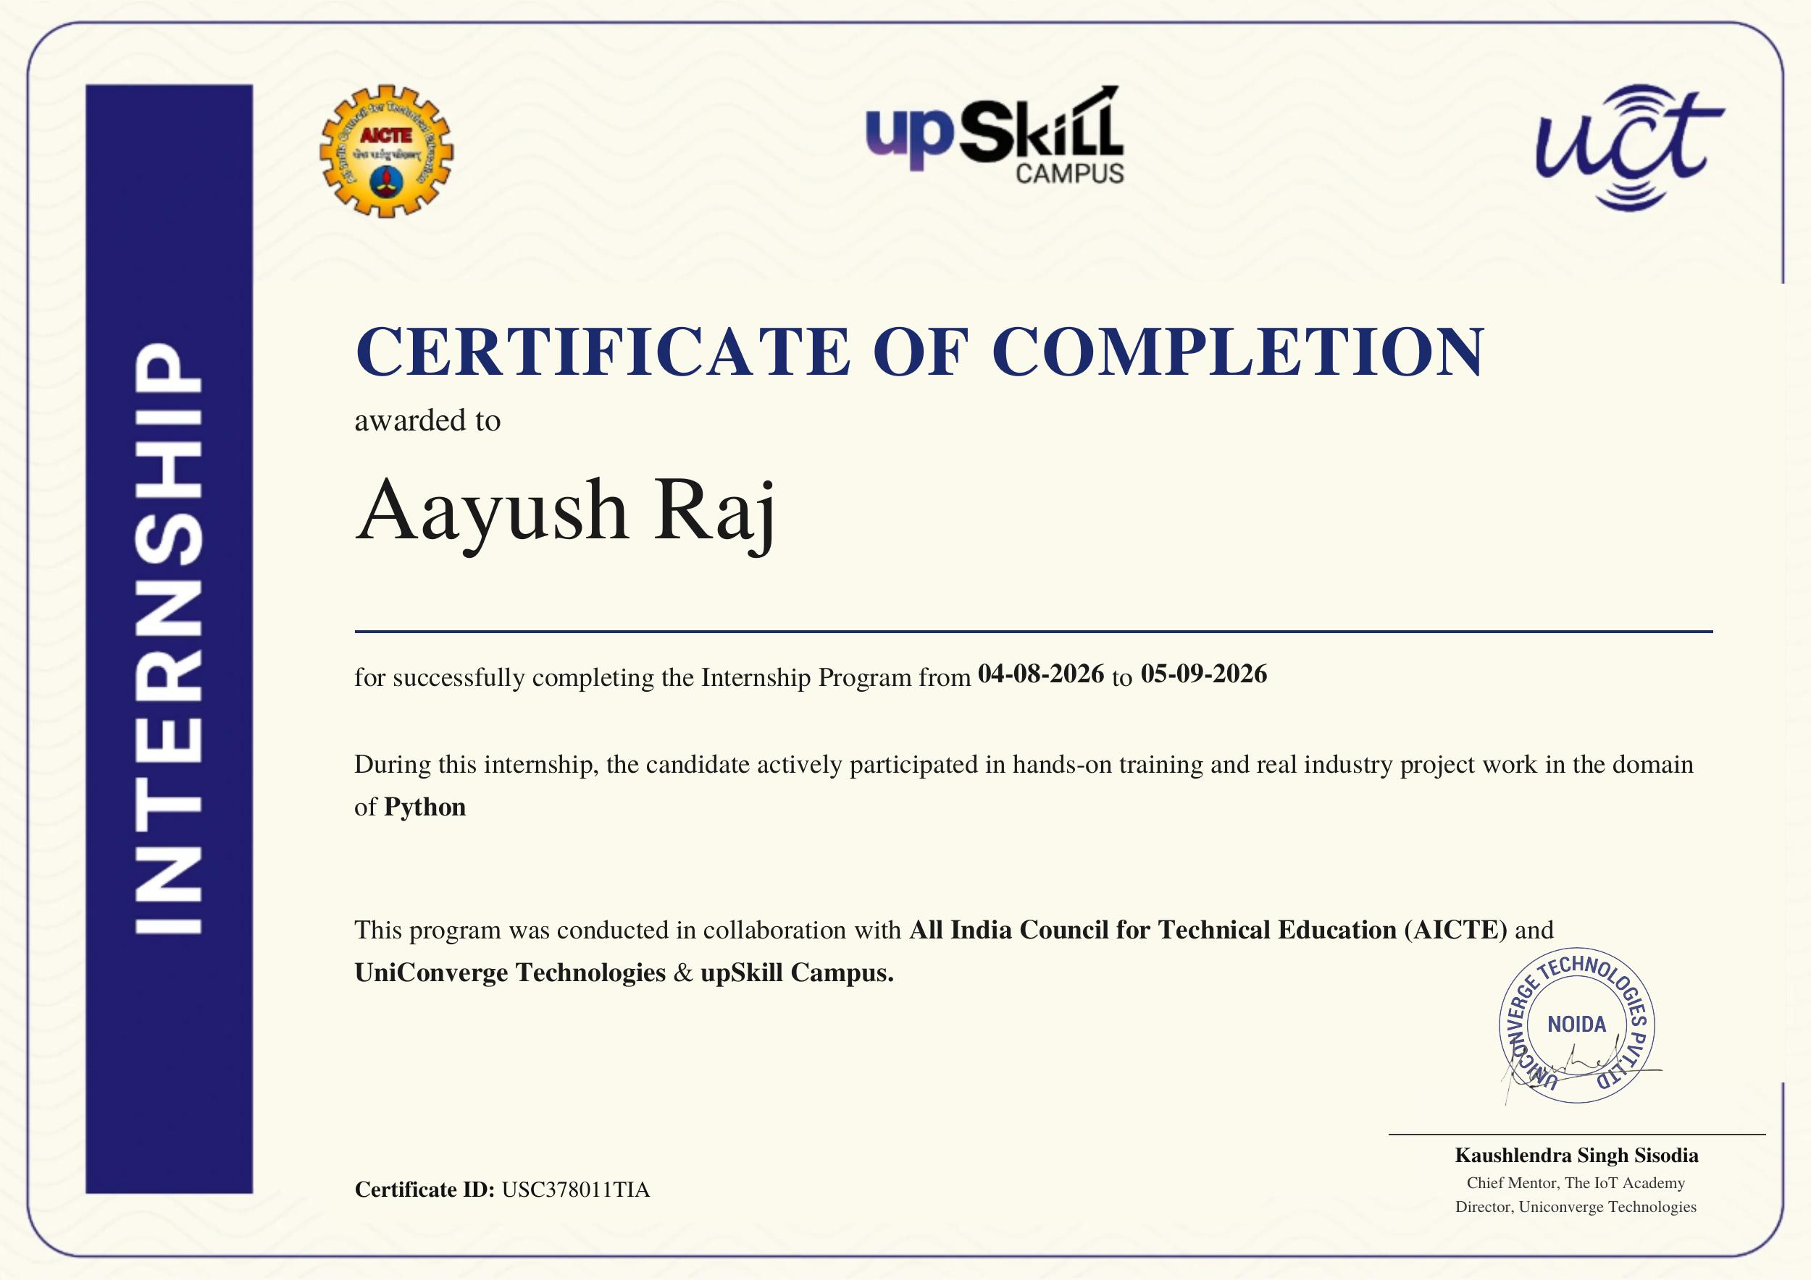
CERTIFICATE OF COMPLETION
Evidence of successful completion
15

Slide 16
Thank You
Questions & Discussion
Python Software Foundation — Python Documentation
Python json module documentation and examples
GitHub Documentation — repositories and source hosting
Upskill Campus / The IoT Academy internship learning resources
16

